Slide 1
PowerPoint 365 Interactive Animation
Stacked Bar
Macro
Assign Macro to Action Link

Slide 2




Site Visit Schedule On January 2021
Suche, China
SME Project
Payet, France
Olympic Project
Somchai, Thailand
Startup Project
Inuae, Japan
Relationship Project

Slide 3
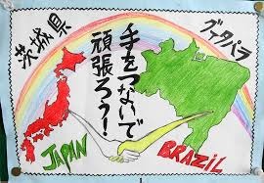
Japan
Once there was a nation that went to war, but after they conquered a continent their own country was destroyed by atom bombs...
Then the victors imposed democracy on the vanquished. For a group of apprentice architects, artists, and designers, led by a visionary, the dire situation of their country was not an obstacle but an inspiration to plan and think...
Although they were very different characters, the architects worked closely together to realize their dreams, staunchly supported by a super-creative bureaucracy and an activist state... after 15 years of incubation, they surprised the world with a new architecture

Slide 4
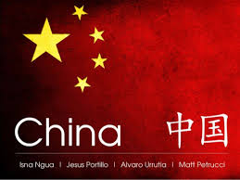
China
Create a Collage of Your Bucket List. ...
Create a Poster. ...
Write Flash Fiction. ...
Write a Manifesto. ...
Write a Poem – Silverstein Style. ...
Become An Idea Machine. ...

Slide 5

Thailand
Looking to volunteer in Thailand? You’ve made a great choice! Thailand, also known as “Asia for beginners”, is a place you’ll feel at ease. It is a country full of beautiful beaches, lots of smiles, and simply a place where you will find it easy to let go of everything. Temples, ancient cities, and tropical rainforest with exotic wildlife are a playground for volunteers who are looking for an adventure abroad. Volunteer in Bangkok, Chiang Mai, or one of the islands and help the local communities or the environment of this world-renown tourist hotspot.

Slide 6
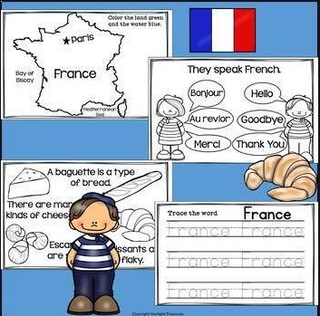
France
Learning topics: Possessives, vocabulary of family and relationships, numbers, years and nationalities.
Activity: For this exercise, give a sample tree in class. Here you have a couple of options: Either create your own family tree ahead of time (complete with photos), or make this a group activity and “invent” a family together with the students.

