Slide 1
Summary of Course PowerPoint 365 Interactive Animation
Motion Path Animation
Stack Bar Chart
Gear Animation
Interactive Animation (Ole Action Verbs)
Interactive Animation (Macro)

Slide 2
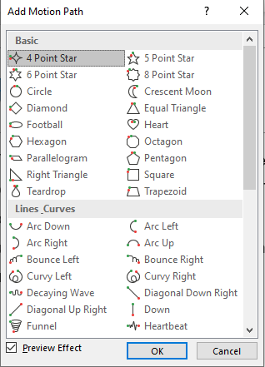
Motion Path
Motion Path Tools is a PowerPoint add-in designed to handle the motions paths included in your presentations. The add-in allows you to determine the end position of a certain shape by generating a duplicate shape in the presentation. You can also use this add-in to join shape paths and to align the ends of a motion path with one click.

Slide 3
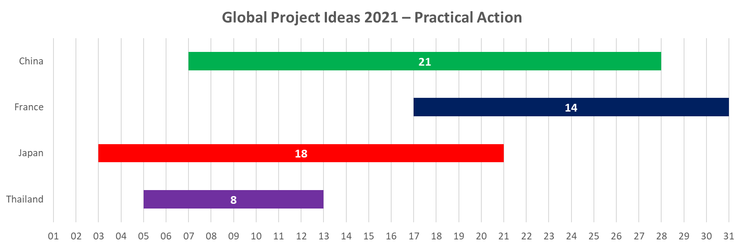
Stacked Bar Chart
A stacked bar chart is a type of bar chart used in excel for the graphical representation of part-to-whole comparison over time. This helps you to represent data in a stacked manner. This type of graph is suitable for data which is represented in different parts and one as a whole. The gradual variation of different variables can be picturized using this.

Slide 4
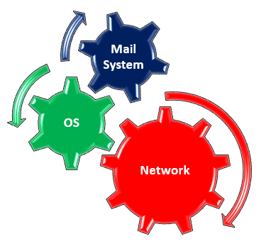
Gear Animation
Gear icons are often used in diagrams and illustrations used for making PowerPoint presentations. This is because gears can be quite helpful in depicting different types of processes, relationships and to represent cohesion and teamwork.

Slide 5
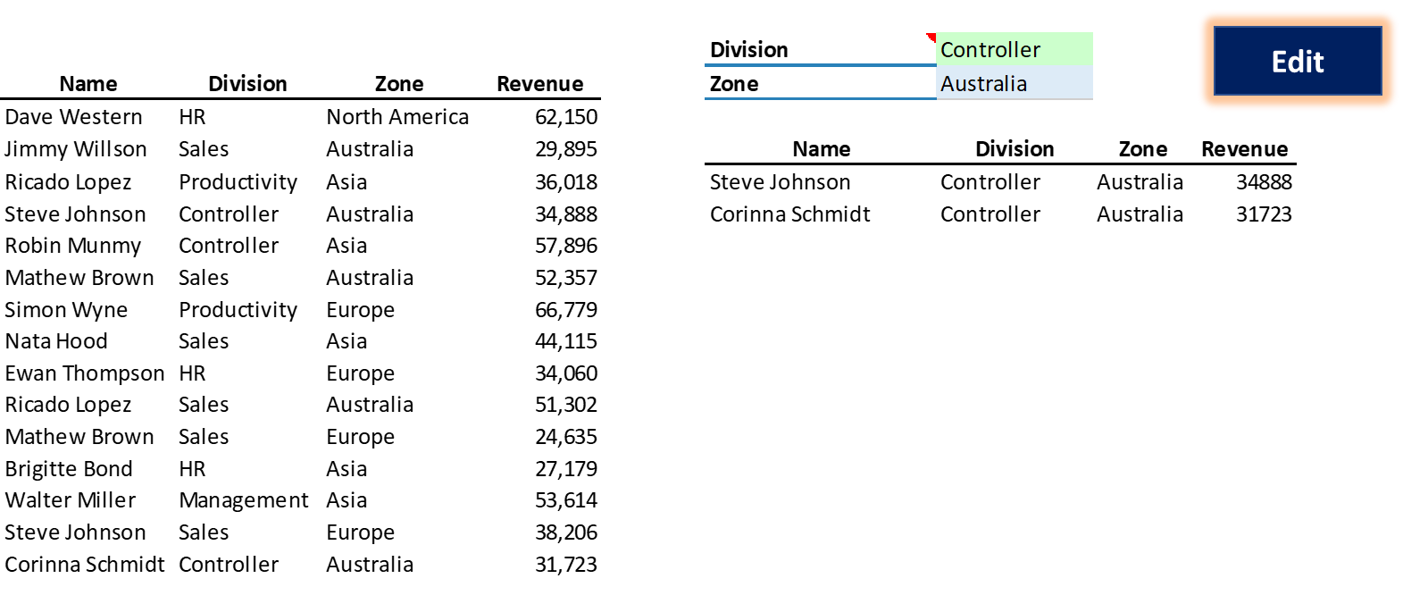
Interactive Animation (Ole Action Verbs)

Slide 6
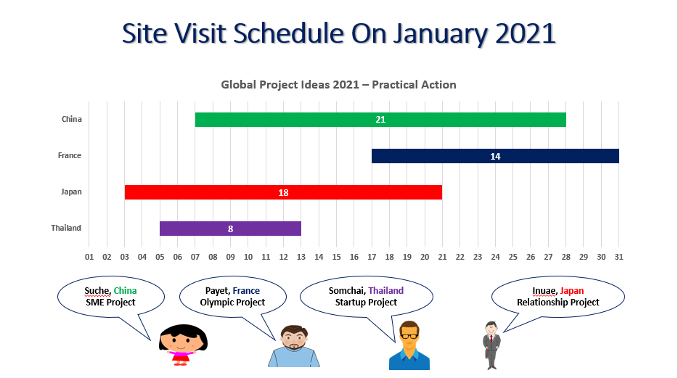
Interactive Animation (Macro)

